Slide 1
CDDRL
Constraint-based approach for structure re-learning

Slide 2
General Algorithm
Input: Previous BN, Changed Nodes
Output: Current BN
Step 1: Keep must stay edges (parents of non-changed nodes)
Step 2: CMI tests for previous edge removal
Step 3: CMI tests for possible edge addition (edges pointing to changed nodes)
* We don’t know the orientation for edges between two changed nodes
Step 4: V-Structures orientation
Step 5: Two edge orientation rules
Step 6: Final edge orientations using BDeu scores
Algorithm
Competitors
SL Experiments
Classification Experiments
Conclusions

Slide 3
Competitors
Ensemble methods:
- KNN-ADWIN (Bifet and Gavalda, 2007)
Average Weighting Ensemble (AWE) (Wang et al., 2003)
Dynamic Weight Majority (DWM) (Kolter and Maloof, 2007)
Learning in Non-Stationary Environments (LNSE) (Elwell and Polikar, 2011)
- Streaming Random Patches (SRP) (Gomes et al., 2019)
Structure learning methods:
K2 (Search & Score) (Cooper, G. F., & Herskovits, E. (1992))
PC (Constraint Based) (Spirtes et al., 2000)
Min Max Hill Climbing – MMHC (Hybrid) (Tsamardinos et al., 2006)
Algorithm
Competitors
SL Experiments
Classification Experiments
Conclusions

Slide 4
Experiments – Structure Learning
Learning the BN structure that was manually changed
Change = Add / Remove / Reverse an edge
Performance Matrices:
Structural Hamming Distance (SHD)
Run Time (Seconds)
Number of CI tests (Relevant only for PC)
BNs Used:
Asia – small
Sachs – small
Alarm – medium
Barley – medium + many parameters
Andes – large
Algorithm
Competitors
SL Experiments
Classification Experiments
Conclusions

Slide 5
Experiments – Structure Learning
Previous graph and changed node were given
K2 ordering was previous ordering and current ordering
Previous approach (S&S) was also tested
4. Data sizes were:
500, 1500, 5000, 15000 – for small networks
50000 – was added to large networks
Algorithm
Competitors
SL Experiments
Classification Experiments
Conclusions

Slide 6
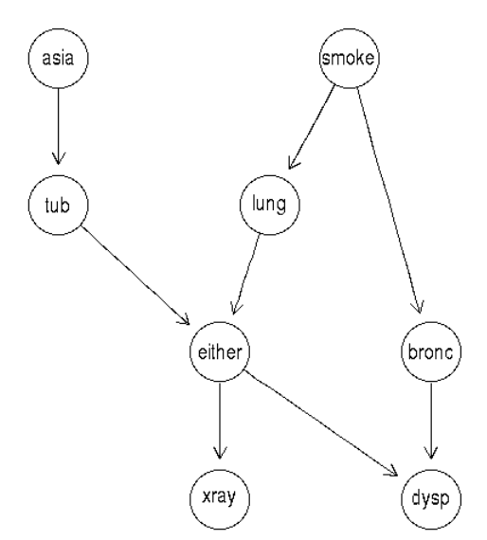
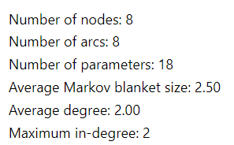
Results - Asia
The connection between lung cancer and visits to Asia
Algorithm
Competitors
SL Experiments
Classification Experiments
Conclusions

Slide 7
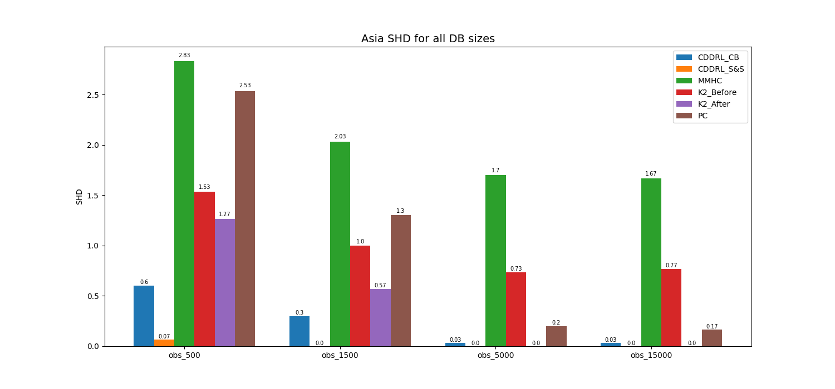
Results – Asia (SHD)
3 experiments were done – adding an edge, removing an edge and reversing an edge.
Results are averages over all three experiments.
Algorithm
Competitors
SL Experiments
Classification Experiments
Conclusions

Slide 8
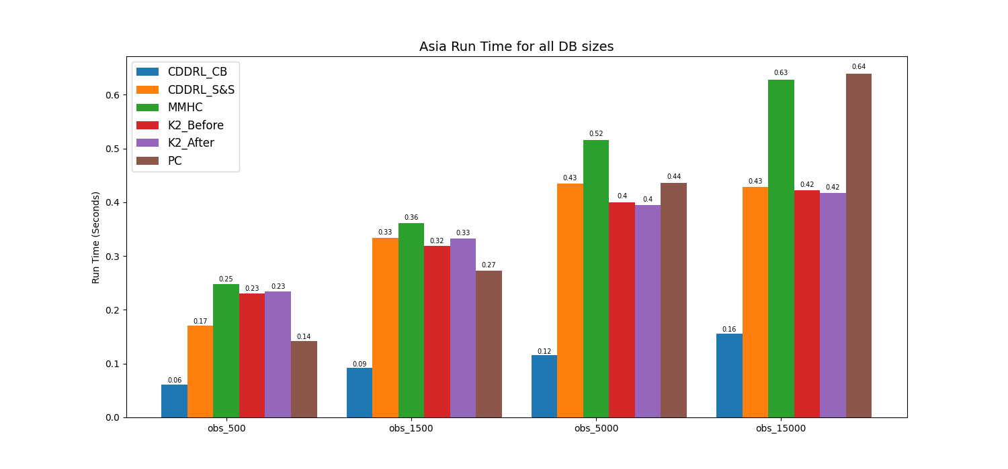
Results – Asia (Run Time)
Algorithm
Competitors
SL Experiments
Classification Experiments
Conclusions

Slide 9
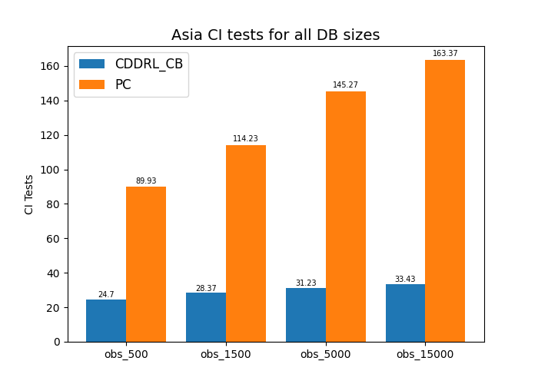
Results – Asia (CI Tests)
Algorithm
Competitors
SL Experiments
Classification Experiments
Conclusions

Slide 10
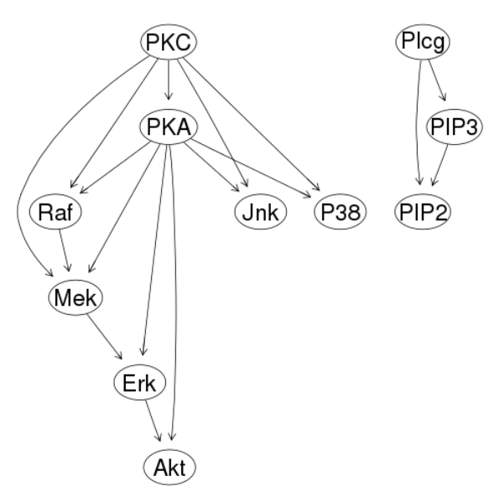
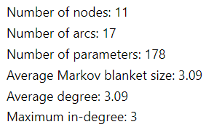
Results - Sachs
K. Sachs, O. Perez, D. Pe'er, D. A. Lauffenburger and G. P. Nolan. Causal Protein-Signaling Networks Derived from Multiparameter Single-Cell Data. Science, 308:523-529, 2005.
Algorithm
Competitors
SL Experiments
Classification Experiments
Conclusions

Slide 11
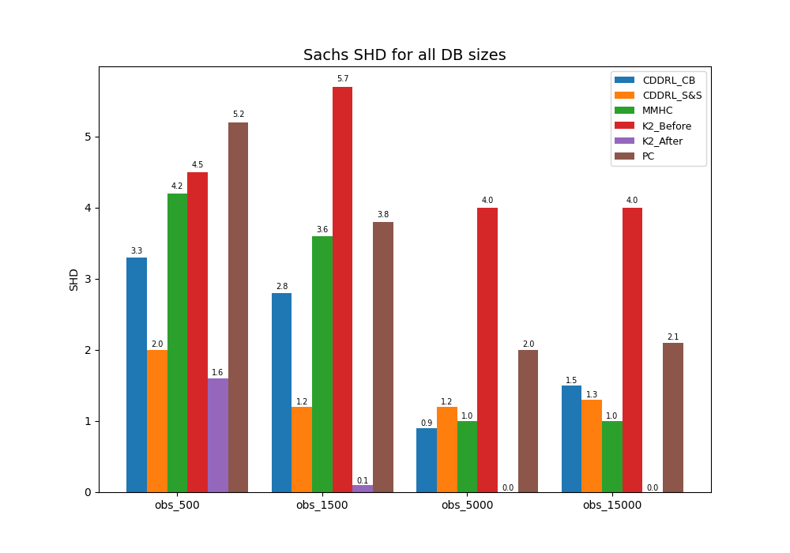
Results – Sachs (SHD)
Algorithm
Competitors
SL Experiments
Classification Experiments
Conclusions

Slide 12
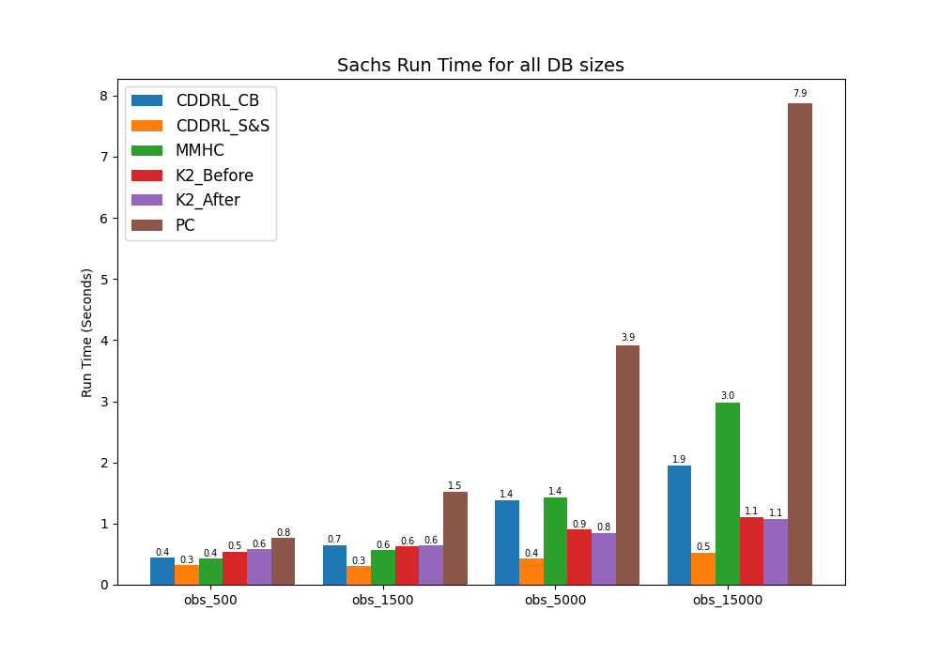
Results – Sachs (Run Time)
Algorithm
Competitors
SL Experiments
Classification Experiments
Conclusions

Slide 13
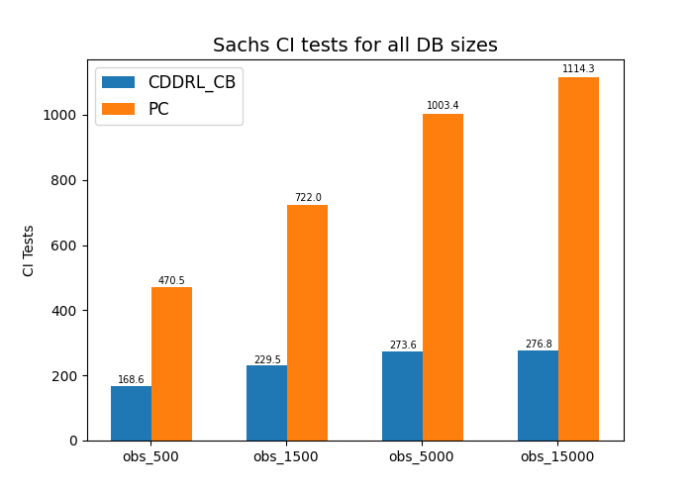
Results – Sachs (CI Tests)
Algorithm
Competitors
SL Experiments
Classification Experiments
Conclusions

Slide 14
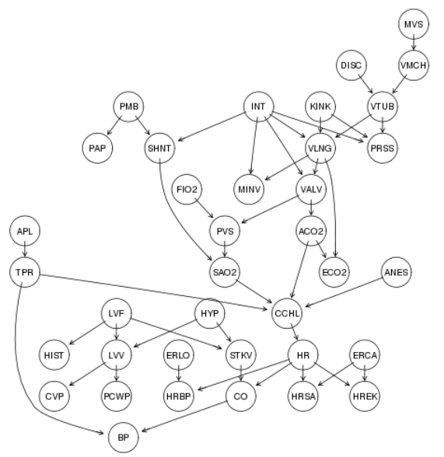
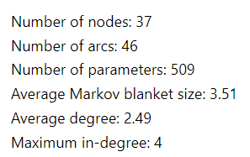
Results - Alarm
I. A. Beinlich, H. J. Suermondt, R. M. Chavez, and G. F. Cooper. The ALARM Monitoring System: A Case Study with Two Probabilistic Inference Techniques for Belief Networks
Algorithm
Competitors
SL Experiments
Classification Experiments
Conclusions

Slide 15
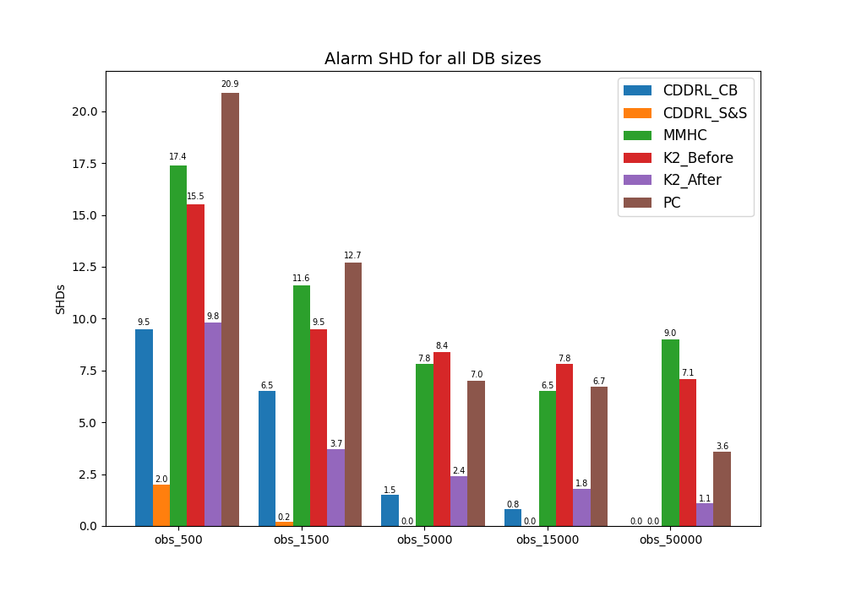
Results – Alarm (SHD)
Algorithm
Competitors
SL Experiments
Classification Experiments
Conclusions

Slide 16
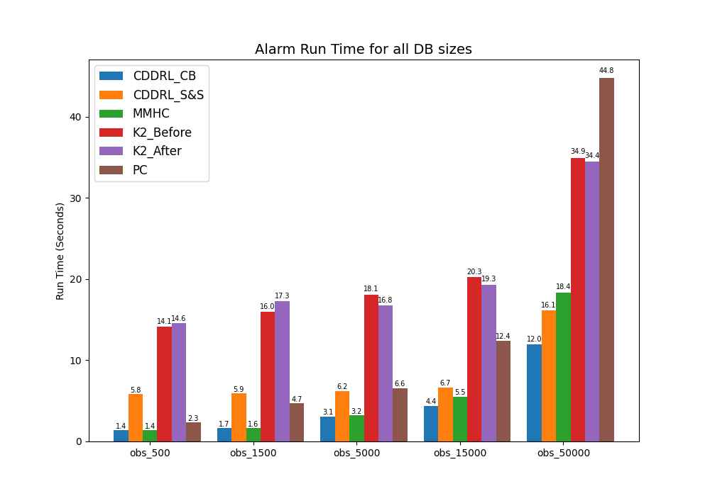
Results – Alarm (Run Time)
Algorithm
Competitors
SL Experiments
Classification Experiments
Conclusions

Slide 17
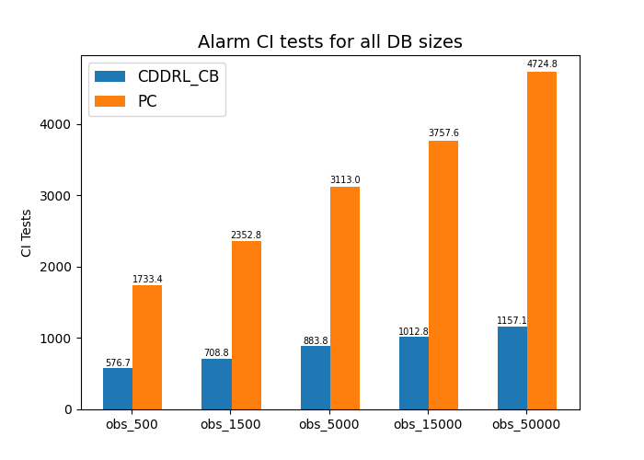
Results – Alarm (CI Tests)
Algorithm
Competitors
SL Experiments
Classification Experiments
Conclusions

Slide 18
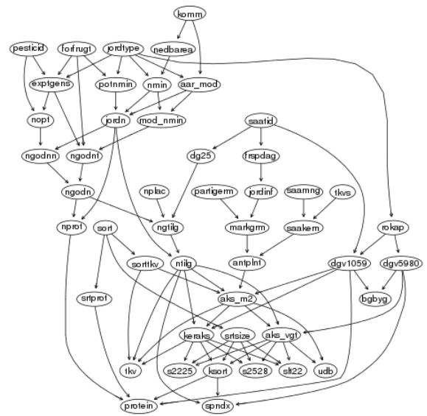
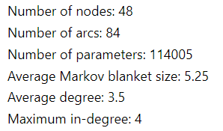
Results - Barley
Preliminary model for barley developed under the project: "Production of beer from Danish malting barley grown without the use of pesticides" by Kristian Kristensen , Ilse A. Rasmussen and others.
Algorithm
Competitors
SL Experiments
Classification Experiments
Conclusions

Slide 19
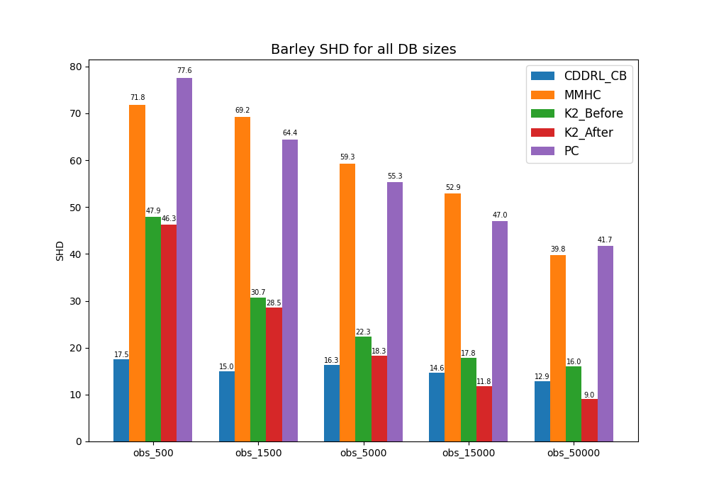
Results – Barley (SHD)
CDDRL Search and Score collapsed – too many graphs generated
Algorithm
Competitors
SL Experiments
Classification Experiments
Conclusions

Slide 20
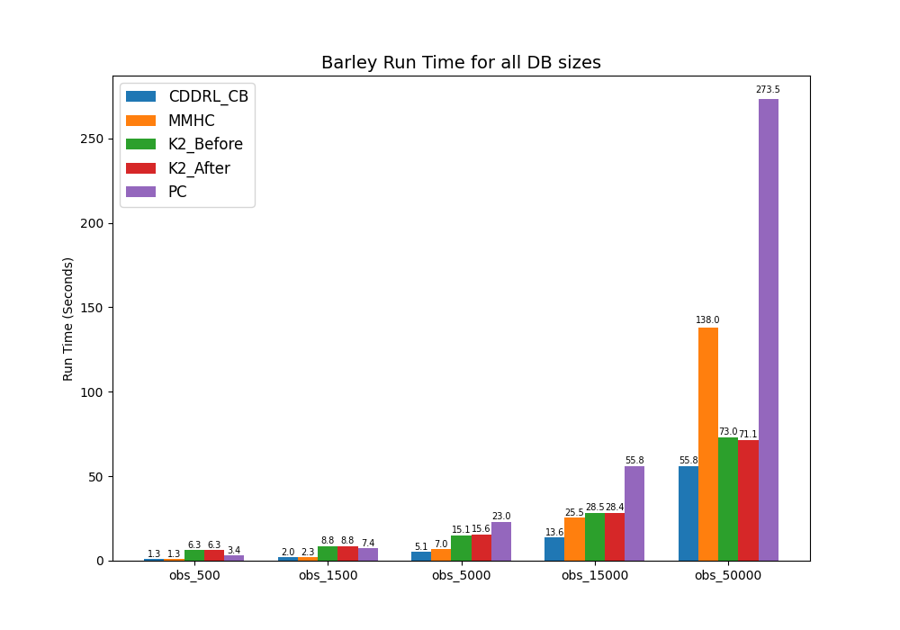
Results – Barley (Run Time)
Algorithm
Competitors
SL Experiments
Classification Experiments
Conclusions

Slide 21
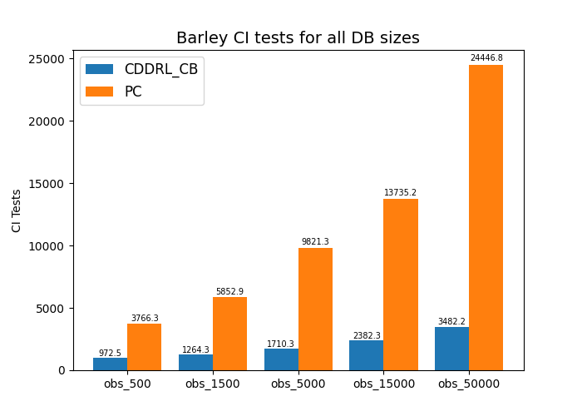
Results – Barley (CI Tests)
Algorithm
Competitors
SL Experiments
Classification Experiments
Conclusions

Slide 22
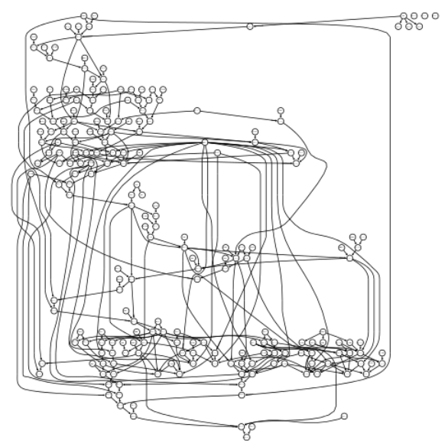
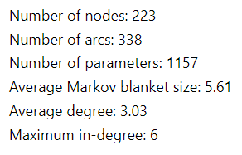
Results - Andes
C. Conati, A. S. Gertner, K. VanLehn, M. J. Druzdzel. On-line Student Modeling for Coached Problem-Solving Using Bayesian Networks.
Algorithm
Competitors
SL Experiments
Classification Experiments
Conclusions

Slide 23
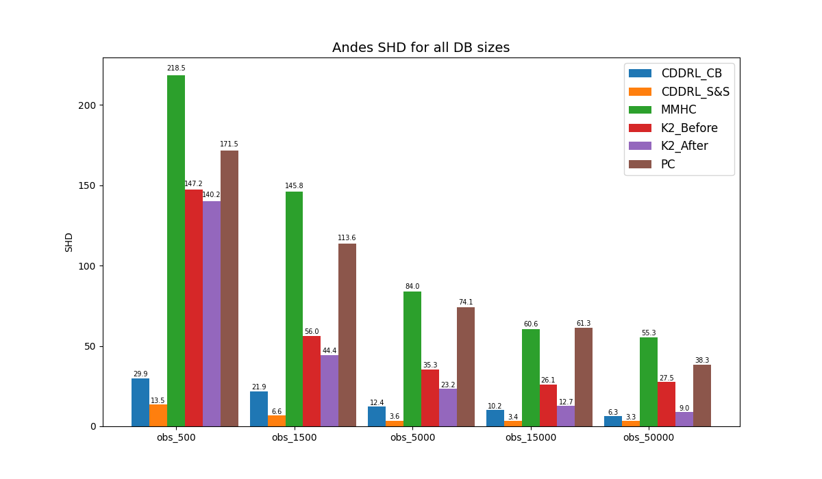
Results – Andes (SHD)
Algorithm
Competitors
SL Experiments
Classification Experiments
Conclusions

Slide 24
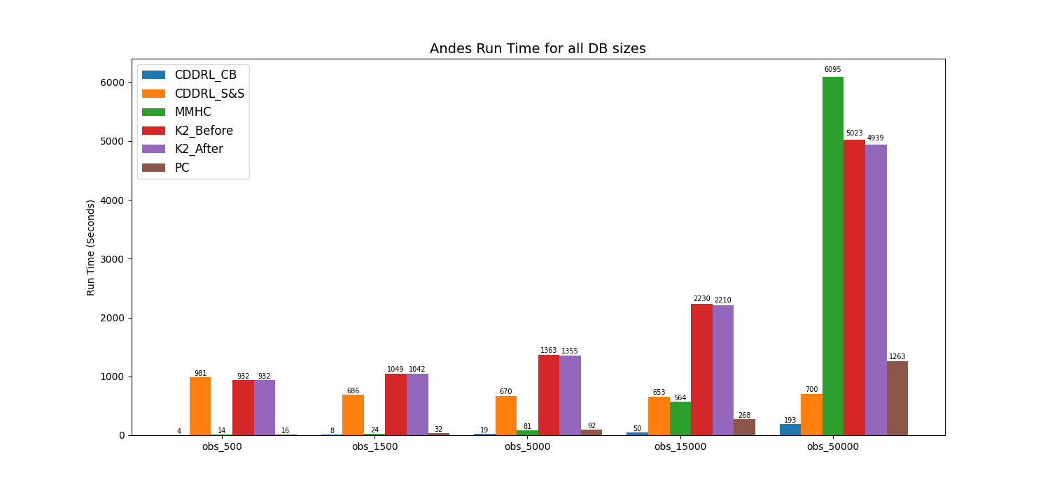
Results – Andes (Run Time)
Algorithm
Competitors
SL Experiments
Classification Experiments
Conclusions

Slide 25
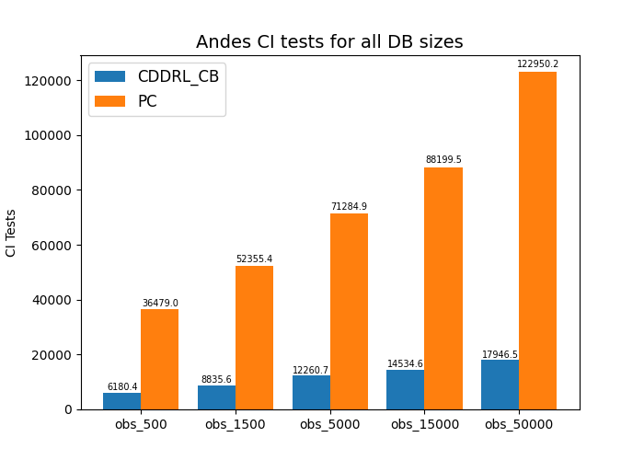
Results – Andes (CI Tests)
Algorithm
Competitors
SL Experiments
Classification Experiments
Conclusions

Slide 26
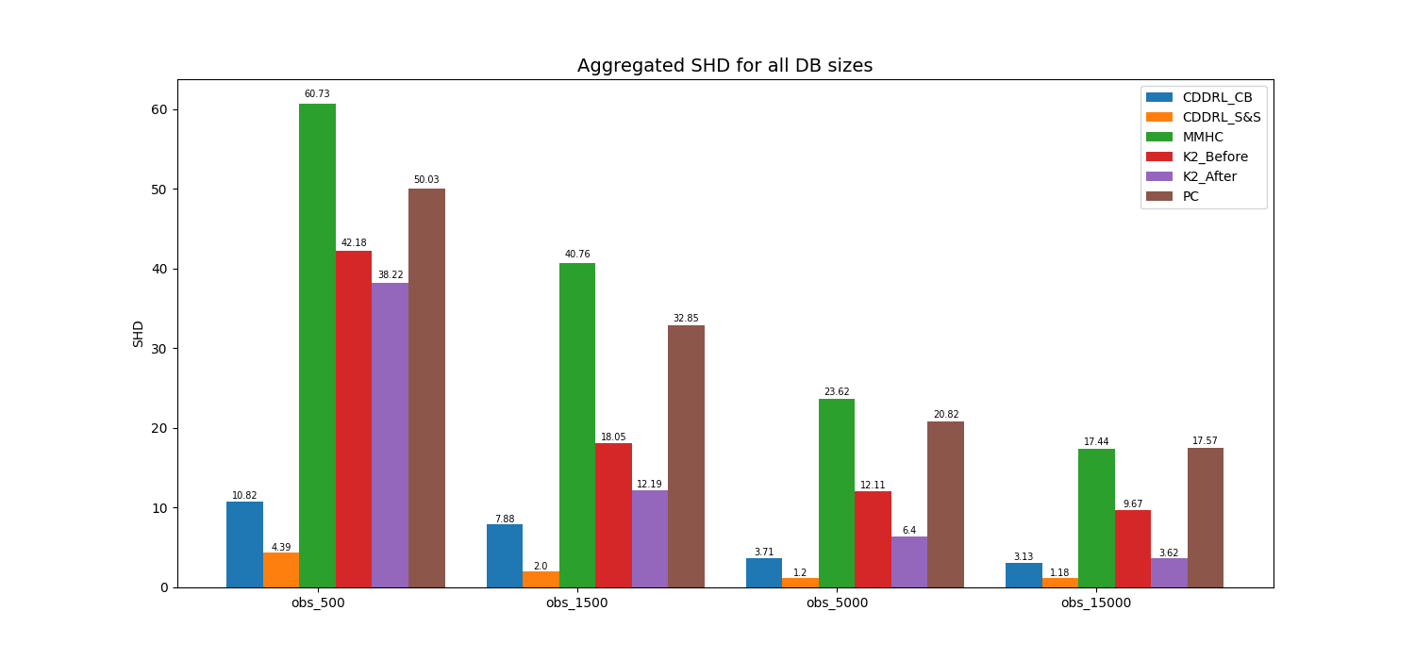
Aggregated Results (Structure Learning)
Algorithm
Competitors
SL Experiments
Classification Experiments
Conclusions

Slide 27
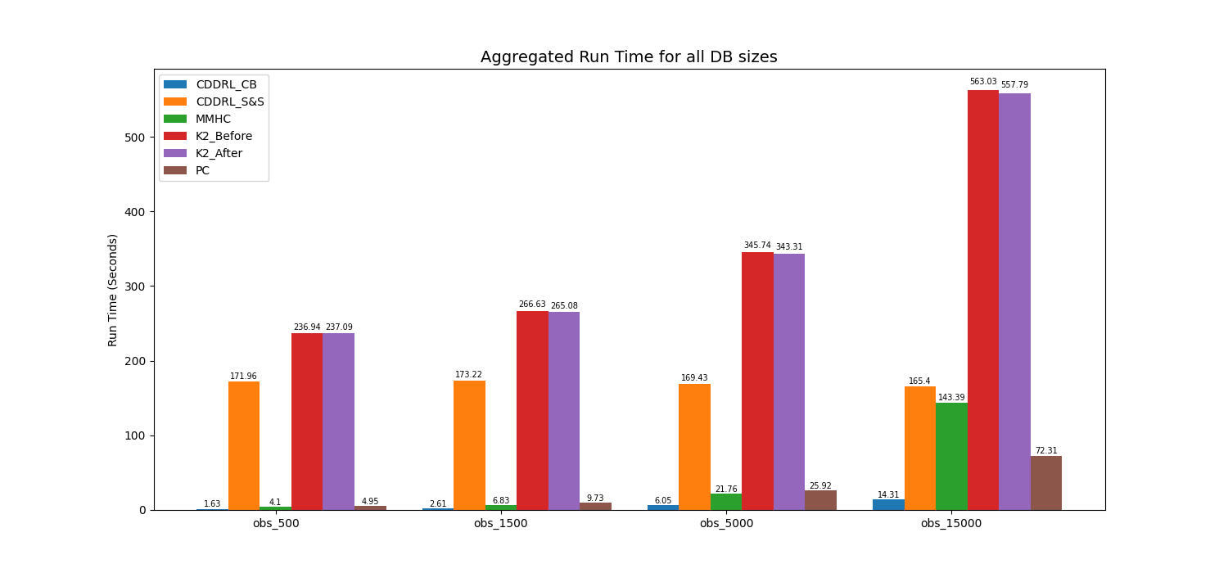
Aggregated Results (Structure Learning)
Algorithm
Competitors
SL Experiments
Classification Experiments
Conclusions

Slide 28
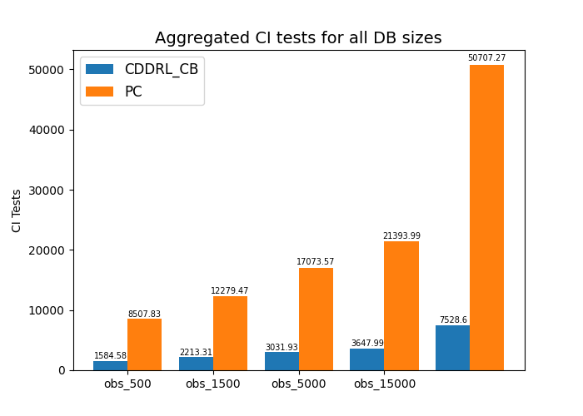
Aggregated Results (Structure Learning)
Algorithm
Competitors
SL Experiments
Classification Experiments
Conclusions

Slide 29
Experiments – Classification
Synthetic concept drift data sets by changing the CF
Performance Matrices:
F1 / Accuracy
Run Time (Seconds)
Data Sets:
Sin
STAGGER
Uniform
Algorithm
Competitors
SL Experiments
Classification Experiments
Conclusions

Slide 30
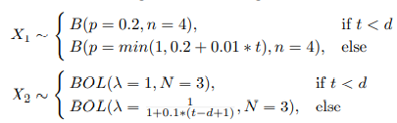

Results – Sin
3 discrete variables that change with time (virtual drift) generated from:
- 5 added features – noise
10 permutations
30,000 observations from 30 time steps
Algorithm
Competitors
SL Experiments
Classification Experiments
Conclusions

Slide 31
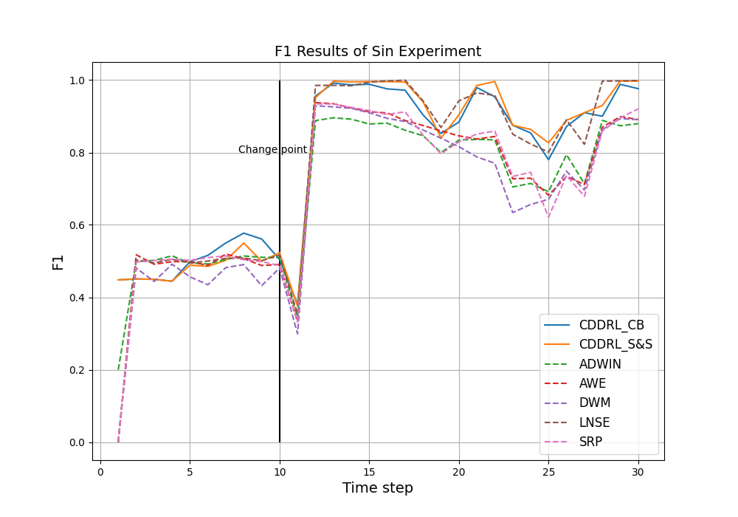
Results – Sin (CDDRL vs. Ensembles)
Algorithm
Competitors
SL Experiments
Classification Experiments
Conclusions

Slide 32
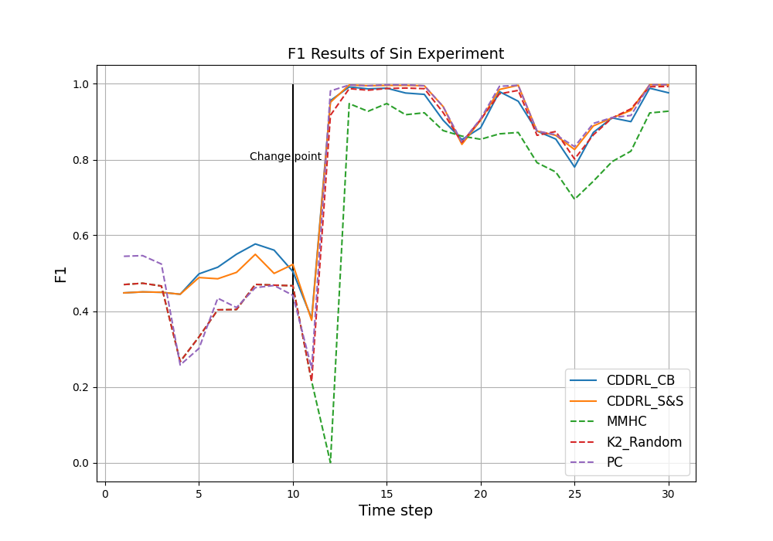
Results – Sin (CDDRL vs. SL Methods)
Algorithm
Competitors
SL Experiments
Classification Experiments
Conclusions

Slide 33
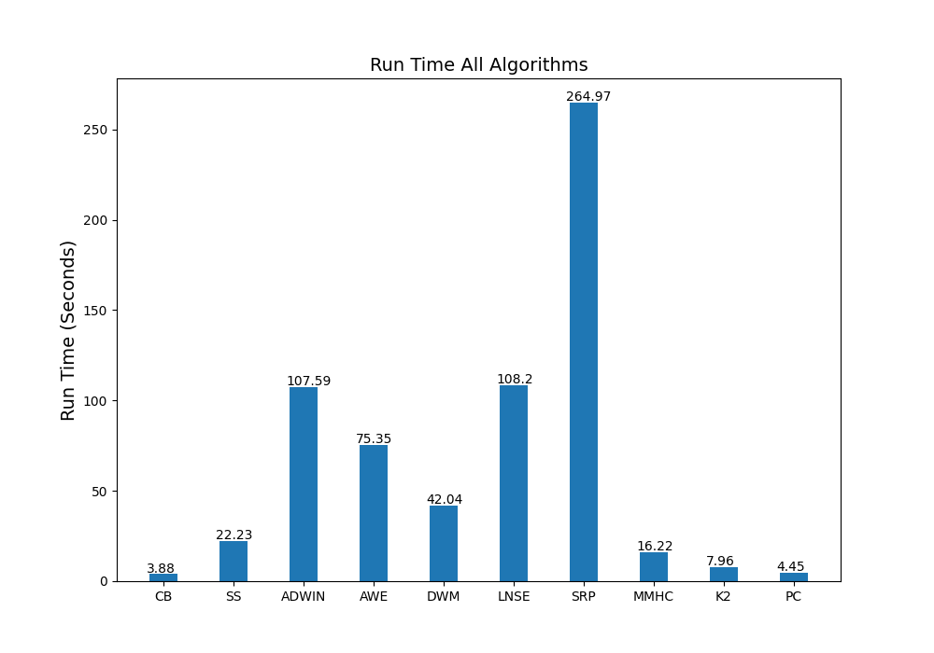
Results – Sin (Run Time)
Algorithm
Competitors
SL Experiments
Classification Experiments
Conclusions

Slide 34

Results – STAGGER
Synthetic data generated by STAGGER – 10 permutations
3 discrete variables (color, size and shape) + 2 noise features
2 class functions – concept drift was introduced by changing the probability to belong to the second class:
- 30,000 observations with 30 time steps
Algorithm
Competitors
SL Experiments
Classification Experiments
Conclusions

Slide 35
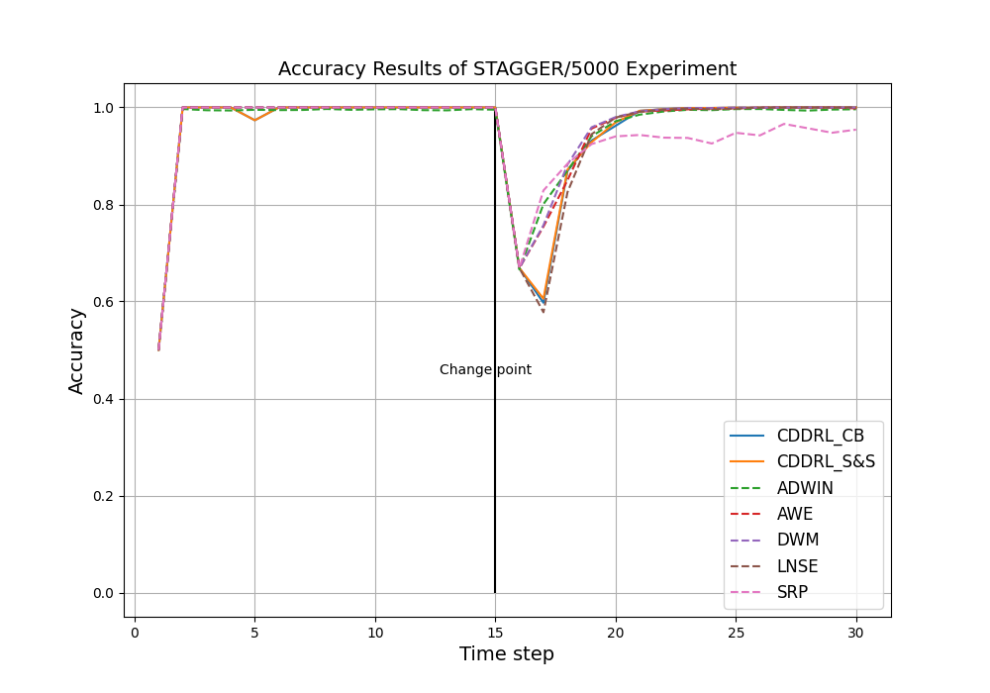
STAGGER (CDDRL vs. Ensembles)
Algorithm
Competitors
SL Experiments
Classification Experiments
Conclusions

Slide 36
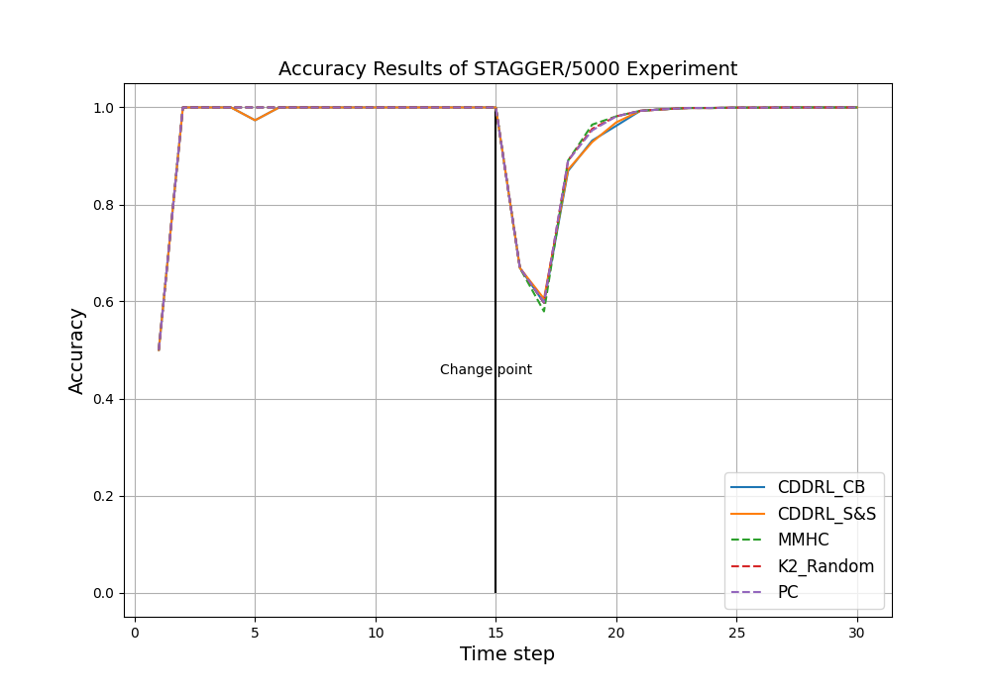
STAGGER (CDDRL vs. SL Methods)
Algorithm
Competitors
SL Experiments
Classification Experiments
Conclusions

Slide 37
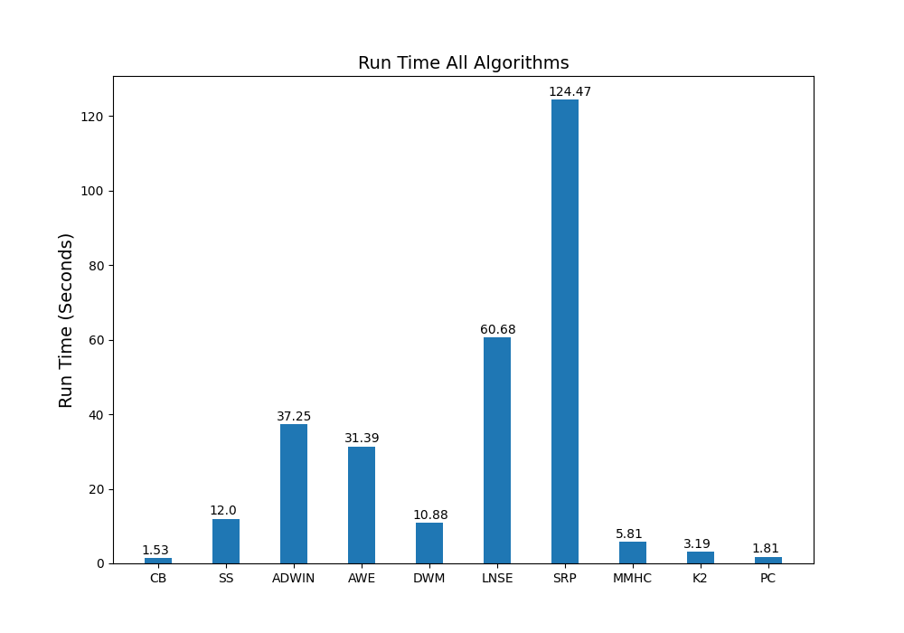
STAGGER (Run Time)
Algorithm
Competitors
SL Experiments
Classification Experiments
Conclusions

Slide 38
Results – Uniform
Synthetic data generated by me – 10 permutations
15 features – first and last five influence the target variable
2 class functions – concept drift was introduced by changing the probability to belong to the second class:
- 60,000 observations with 20 time steps
Algorithm
Competitors
SL Experiments
Classification Experiments
Conclusions

Slide 39
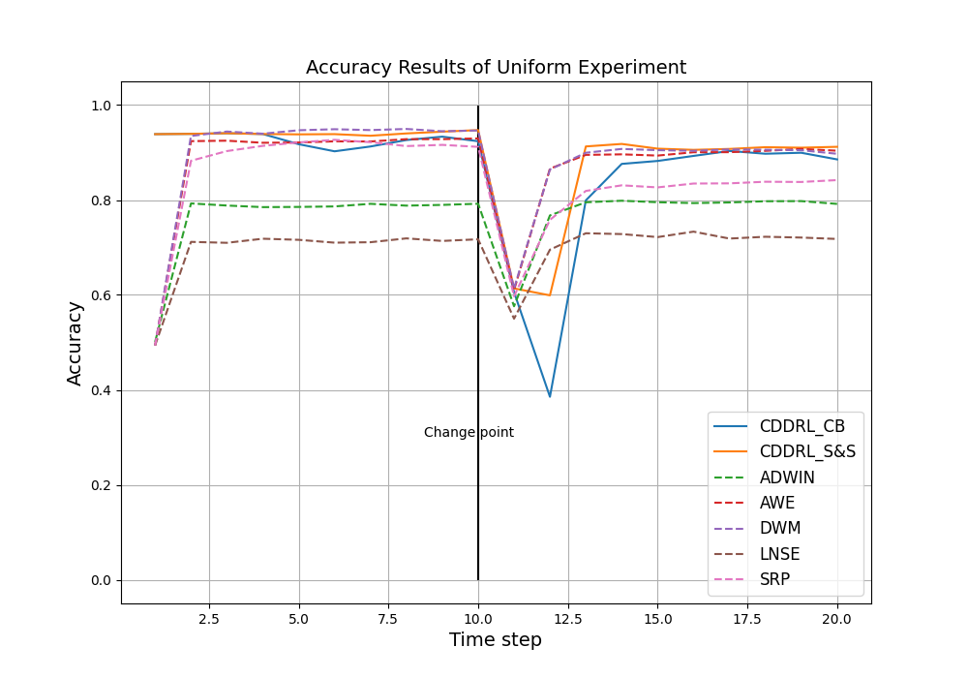
Uniform (CDDRL vs. Ensembles)
Algorithm
Competitors
SL Experiments
Classification Experiments
Conclusions
Notes:
In this experiment, we sampled 15 features uniformly between 1 and 4 for each dataset (10 permutations). The first classification function classifies a sample as 1 if the average of the first 5 features is higher than 2.5 and the second classification function classifies a sample as 1 if the average of the last 5 features is smaller than 2.5. Features 6 – 10 are noise features. We sampled 60,000 samples, where the probability that the $t^{th}$ example belongs to the second classification function is given by the same formula in the STAGGER experiment where the drift position is after 10 timesteps and the drift width is 5000 observations. In addition, a 5% noise was added to the process to make the problem more difficult and realistic. We consider each 3000 observations as a timestep, resulting in overall 20 timesteps (10 before and 10 after the drift).

Slide 40
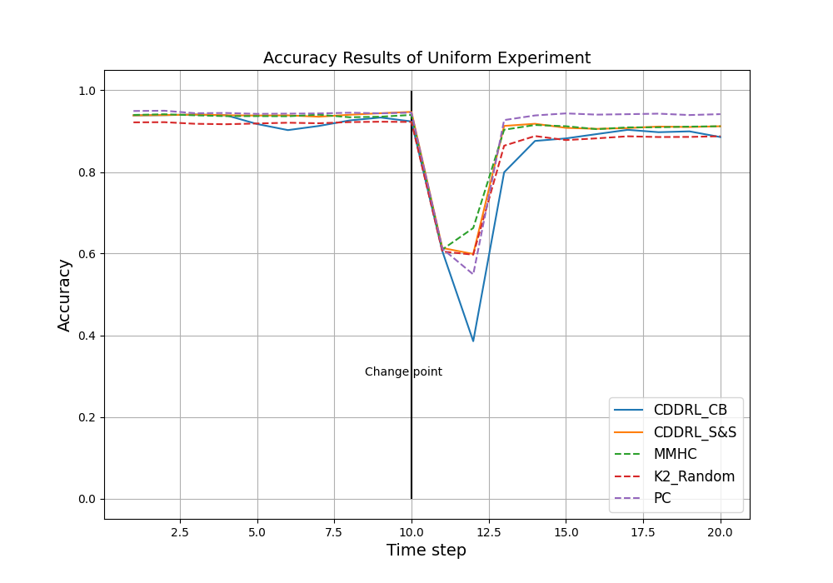
Uniform (CDDRL vs. SL Methods)
Algorithm
Competitors
SL Experiments
Classification Experiments
Conclusions

Slide 41
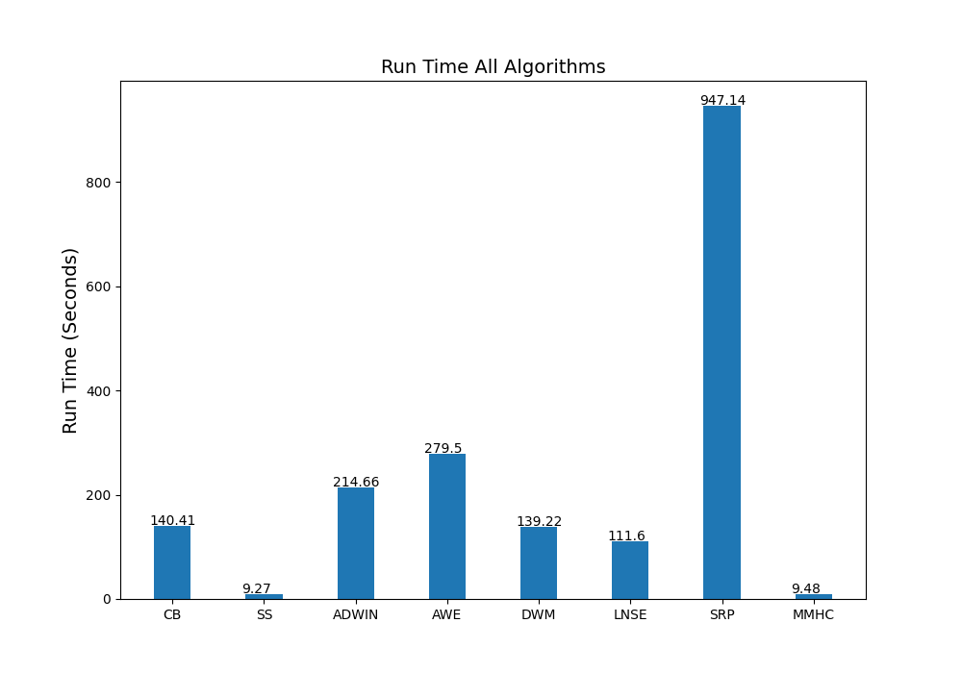
Uniform (Run Time)
Algorithm
Competitors
SL Experiments
Classification Experiments
Conclusions

Slide 42
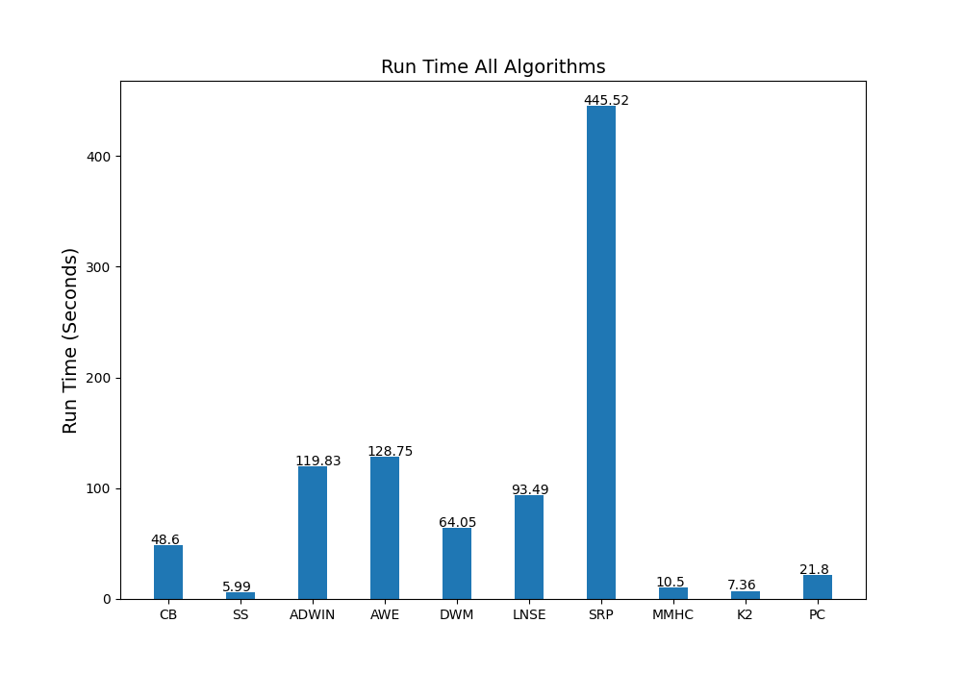
Aggregated Results (Classification)
Algorithm
Competitors
SL Experiments
Classification Experiments
Conclusions

Slide 43
Conclusions
CB shows inferior performance results to the S&S approach.
CB shoes superior performance in most cases to the other competitors.
CB is the fastest method.
CB can be improved by trying different thresholds and implementing v-structures contradiction.
Missing edges are the most influencing factors of CB mistakes, followed by wrong direction edges and then extra edges.
Algorithm
Competitors
SL Experiments
Classification Experiments
Conclusions

Slide 44
Example
BN before change
BN after change
1
2
6
1
2
6
4
5
4
5
3
3
Added:
{6 -> 3}
Removed:
{4 -> 3}
Reversed:
{1 -> 2} , {1 -> 4}
Changed Nodes:
[1, 2, 3, 4]
Non-Changed Nodes:
[5, 6]
Topic
CI
Algorithm
Example
Analyzing & Progress

Slide 45
Step 1: Must Have Edges
A node is considered changed if it has at least one node that is added\removed as a parent (pointing at it)
Non-changed nodes keep the same set of parents
Non-Changed Nodes:
[5, 6]
Edges that must stay:
{2 -> 5}, {3 -> 5}, {2 ->6}
BN before change
BN Step1
1
2
6
1
2
6
4
5
4
5
3
3
Topic
CI
Algorithm
Example
Analyzing & Progress

Slide 46
Step 2: CMI Tests for Edge Removal
Check if previous edges should be removed
The conditioning set is the PC from previous BN
PC1 = [2,4], PC4 = [1,3]
PC2 = [1,5,6], PC5 = [2,3]
PC3 = [4,5], PC6 = [2]
BN before change
1
2
6
4
5
3
BN Step2
Edges to check
{1 – 2}: dependent in all orders
{1 – 4}: dependent in all orders
{3 – 4}: independent given []
1
2
6
4
5
3
Topic
CI
Algorithm
Example
Analyzing & Progress

Slide 47
Step 3: CMI Tests for Edge Addition
Check addition of edges that weren’t tested yet
and that point to changed nodes
The conditioning set is the PC from previous BN
PC1 = [2,4], PC4 = [1,3]
PC2 = [1,5,6], PC5 = [2,3]
PC3 = [4,5], PC6 = [2]
Edges to check
{3 – 1}: PC13[2,4,5] independent given [2]
{5 –> 1}: PC15[2,3,4] independent given [2]
{6 –> 1}: PC16[2,4] independent given [2]
{3 – 2}: PC23[1,4,5,6] independent given [6]
{4 – 2}: PC24[1,3,5,6] independent given []
{6 –> 3}: PC36[2,4,5] always dependent
{5 –> 4}: PC45[1,2,3] independent given []
{6 –> 4}: PC46[1,2,3] independent given []
BN Step3
1
2
6
4
5
3
Topic
CI
Algorithm
Example
Analyzing & Progress

Slide 48
Step 4: V-Structures
BN Step3
If nodes A, B, C hold the following rules:
A - B - C / A -> B - C / A - B <- C
A & C are not connected at all
B is not in separation set of A, C
Then: A -> B <- C
1
2
6
4
5
3
BN Step4
1
2
6
Check nodes 2 – 1 – 4:
1 is not in separation set of 2, 4 - they are independent given [] (from step 3)
4
5
3
Topic
CI
Algorithm
Example
Analyzing & Progress

Slide 49
Step 5: Edge Orientation rules
Rule 1: (Serial connections)
A -> B - C / A - B <- C
A & C are not connected at all
B is in separation set of A, C
Then: A -> B -> C / A <- B <- C
Rule 2: (No cycles allowed)
A - B
There is a directed path from A to B
Then: A -> B
Rule 2 example
A
B
C
If B -> A we get a cycle
* Do iteratively until no more change
Topic
CI
Algorithm
Example
Analyzing & Progress

Slide 50

Step 6: BDeu Score
If there are still unoriented edges:
Create all possible graphs (orienting the edges with no cycles)
Give a BDeU score for all created graphs
Chose the graph with the best BDeu score
Given graph G and data D, BDeu calculates the fitness of graph G to data D:
Topic
CI
Algorithm
Example
Analyzing & Progress

Slide 51
Extra Edge Mistake
BN before change
BN after change
2
4
5
2
4
5
1
6
1
6
3
3
4 is not in PC16 in BN before change, therefore we will not check it as a condition set between 1 and 6.
We will mistakenly learn 1 -> 6.
This is true only if 4 is not a collider.
Topic
CI
Algorithm
Example
Analyzing & Progress

